Slide 1
Printed Circuit Board Design on AutoDesk Eagle
By: Sriram Boppana
How to think[Box]!

Slide 2
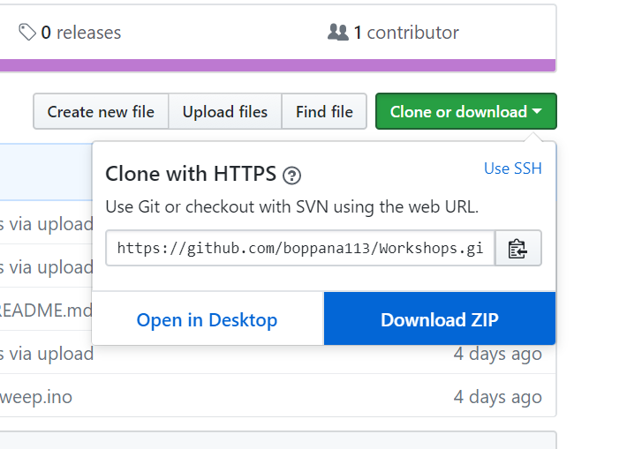
Before we begin
Follow this link and download the repository:
https://github.com/boppana113/Workshops
Unzip the .zip file
Open the powerpoint for this workshop
Download AutoDesk Eagle if you have not already:
https://www.autodesk.com/products/eagle/free-download
If you do not have a computer, please let us know so we can provide you a computer with Eagle installed already

Slide 3
Agenda
What is a Printed Circuit Board?
Intro to AutoDesk Eagle
Design an Accelerometer Breakout board
Schematic Layout
Board Layout
Order your PCB?
Where can I learn more?

Slide 4
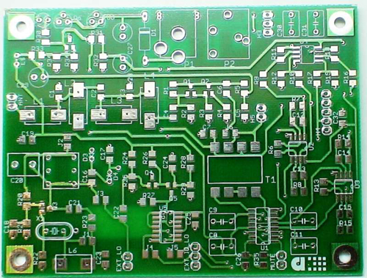
What is a Printed Circuit Board (PCB)?
PCBs mechanically support and connects electronic components together that are connected using conductive and insulated materials.
Found in virtually all modern electronics from computers, mobile devices, and other gadgets

Slide 5
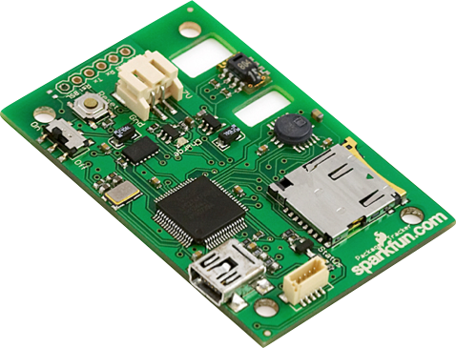
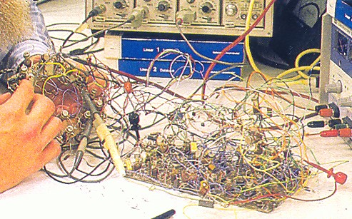
What is a Printed Circuit Board (PCB)?
Photo from hephaestusaudio.com
Photo from www.sparkfun.com

Slide 6
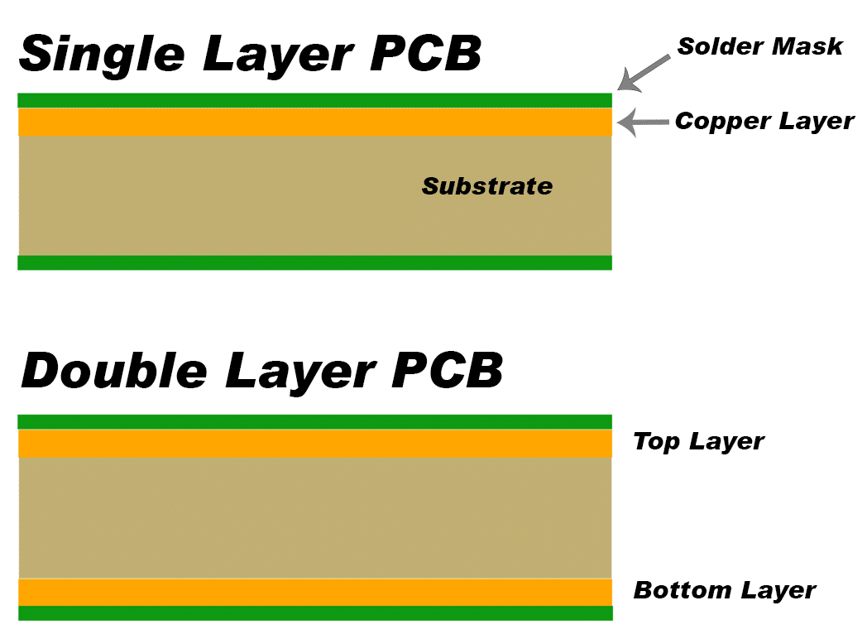
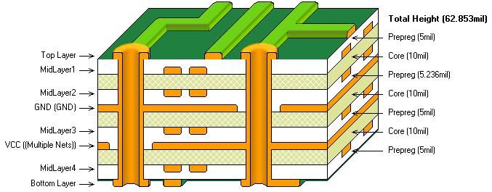
PCB Layers: 1, 2 or more?

Slide 7
EAGLE: A CAD Tool for Designing a Board
Control Panel
Project
Schematic
Layout
Board
Layout
Add your components
Connect Everything together

Slide 8
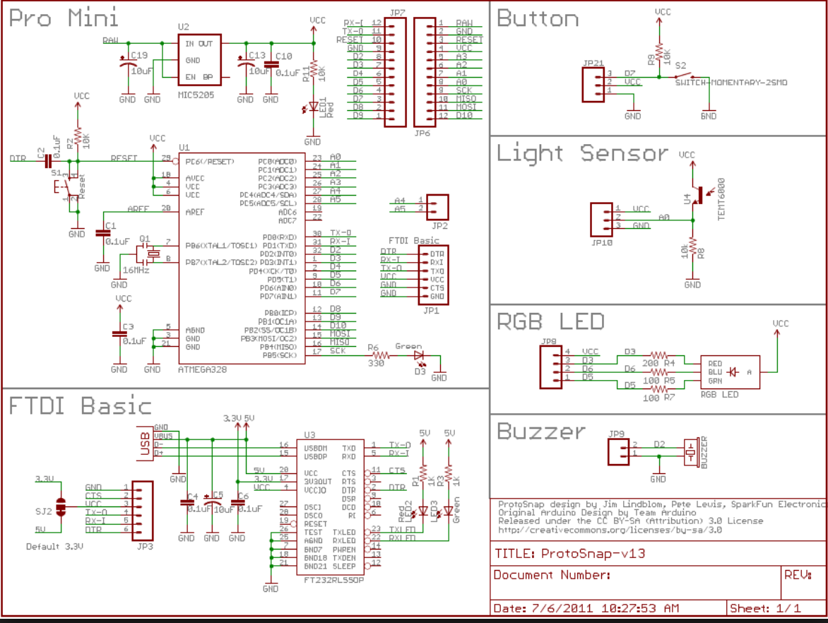
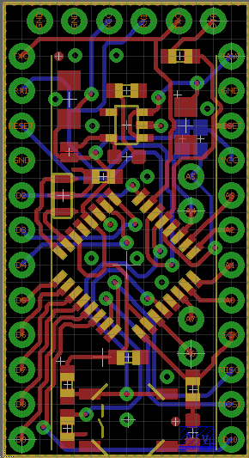
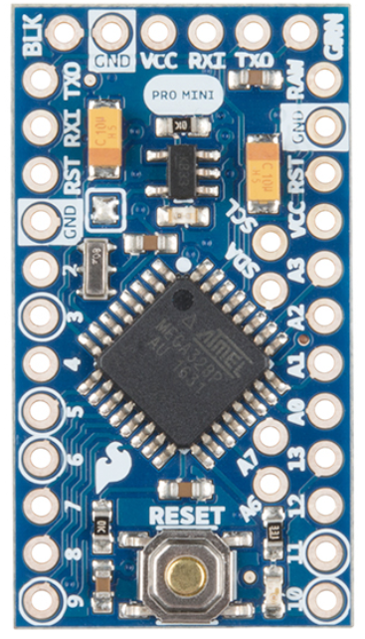
Schematic and Board Layout
Schematic Layout
Board Layout
PCB

Slide 9
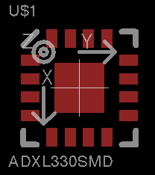
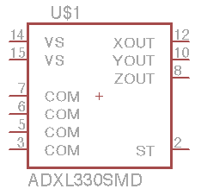
Symbol + Footprint + Device = Component
Symbol
Sym
Device
Dev
Footprint
Pac
Schematic Capture
Layout

Slide 10
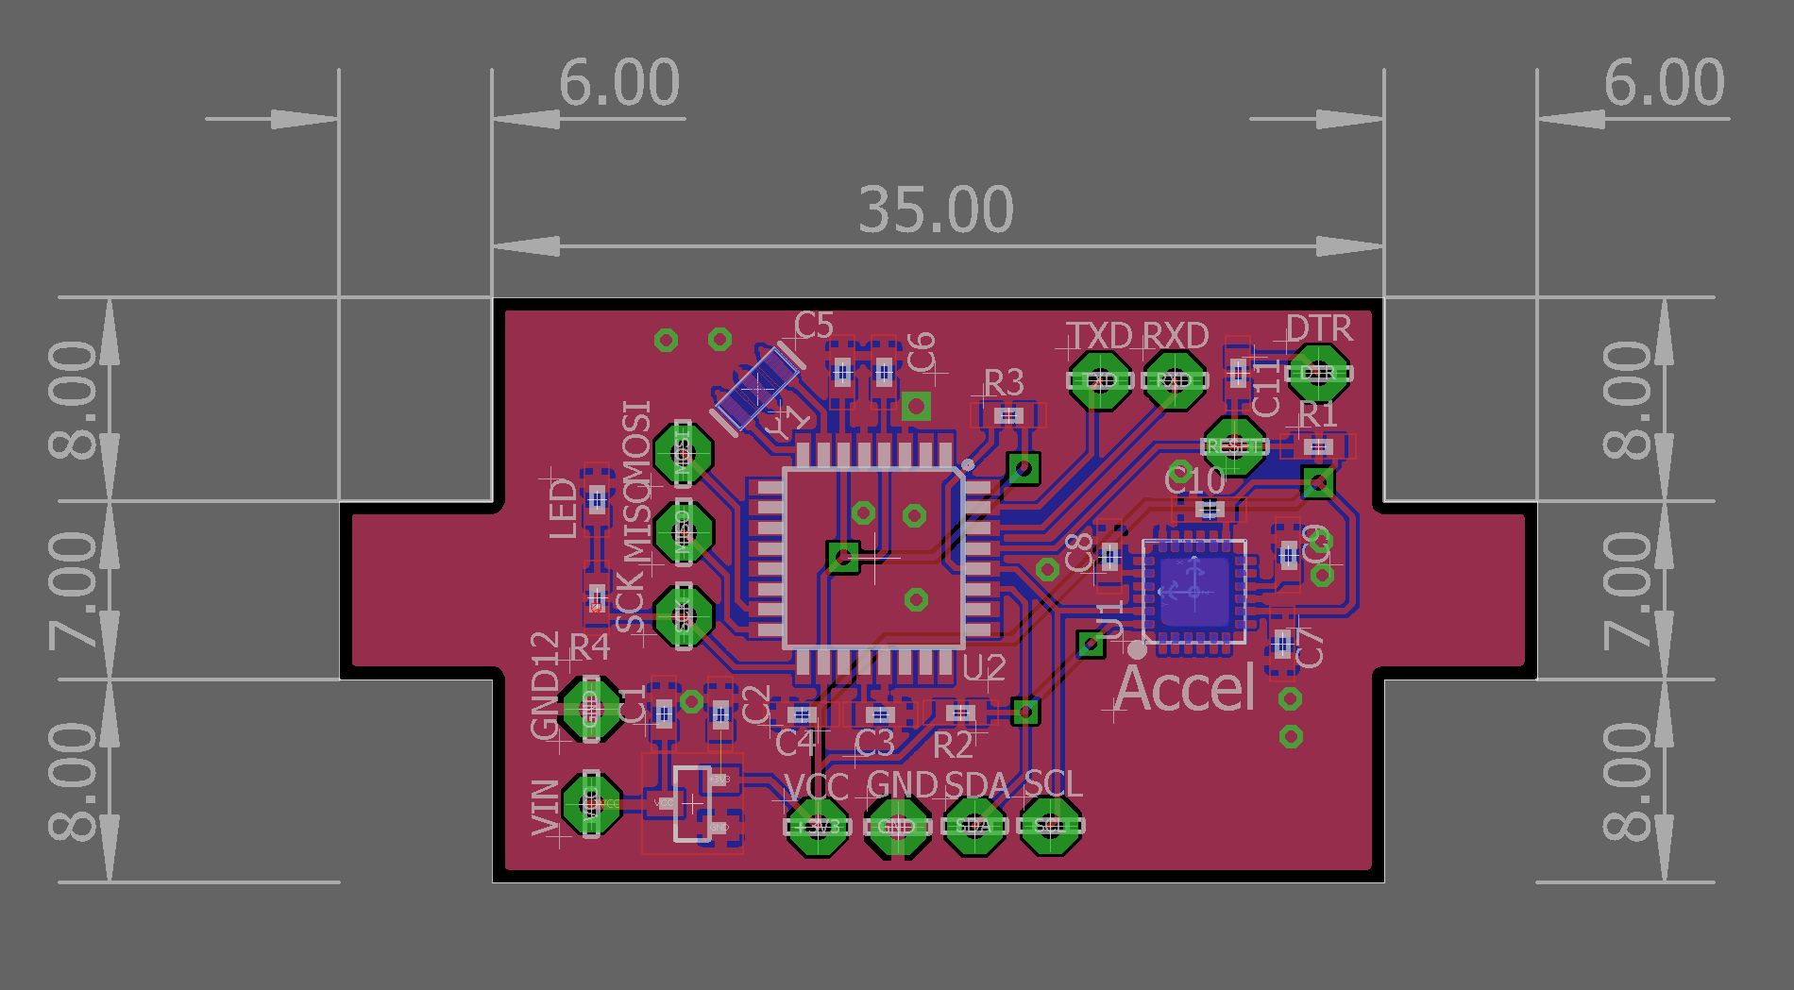
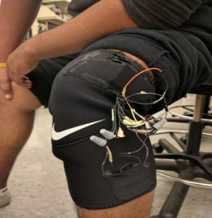
Example PCB Design: IntelliSleeve

Slide 11
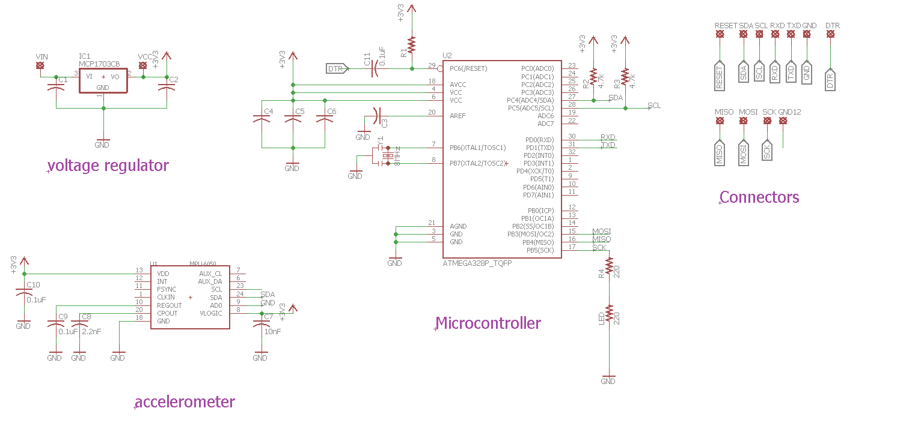
Schematic: IntelliSleeve

Slide 12
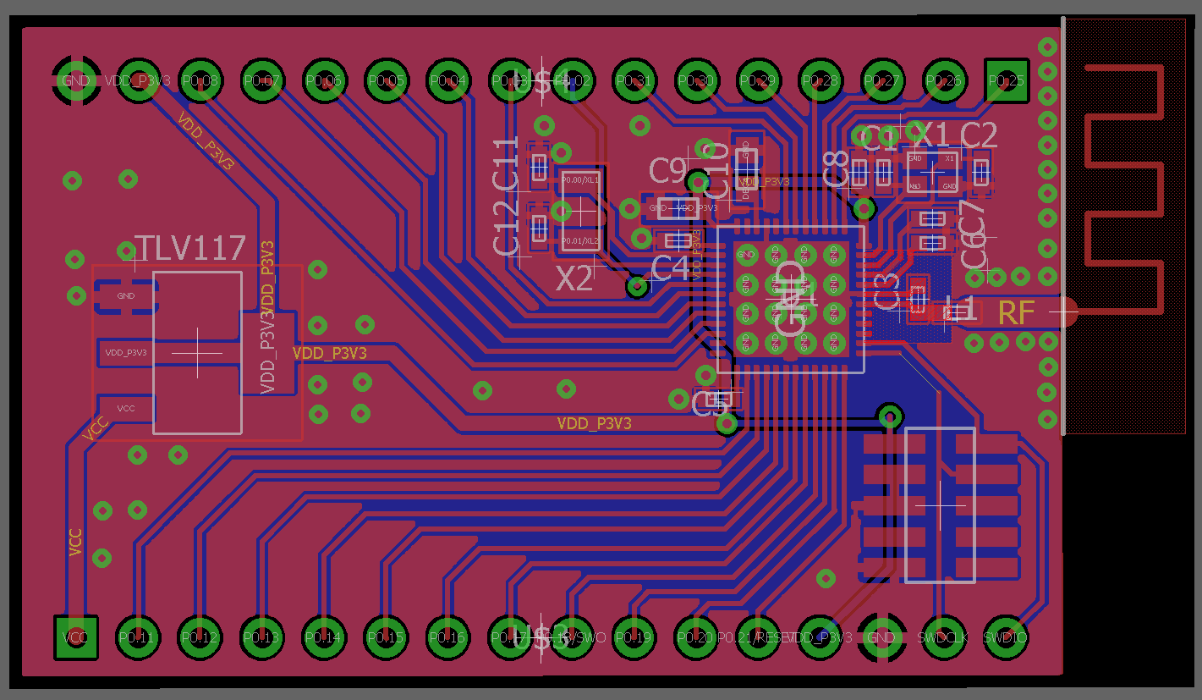
Example PCB Design: NRF52 SoC with Bluetooth Antenna Breakout

Slide 13
Stuff I need to get started
A Plan
Component Selection
Connections and Testing Considerations
Power and Performance Considerations
A New Project
Access to the library and components you need

Slide 14
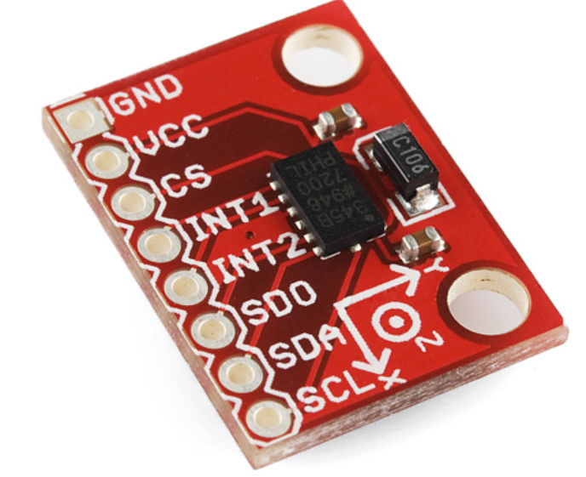
Design an Accelerometer Breakout
For this workshop, you will design an ADXL345 accelerometer breakout board.
3 axis accelerometer
https://www.sparkfun.com/products/9836

Slide 15

How does an accelerometer work?

Slide 16
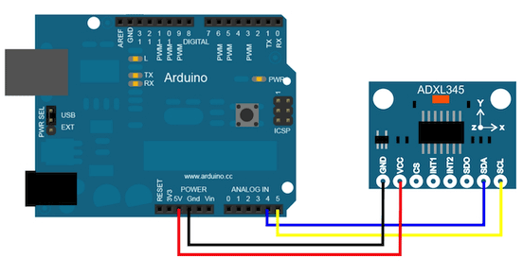
How does ADXL 345 send acceleration data?
ADXL organizes the data using the I²C communication protocol
https://learn.sparkfun.com/tutorials/i2c
The Arduino decodes the data from I²C which the user can read

Slide 17
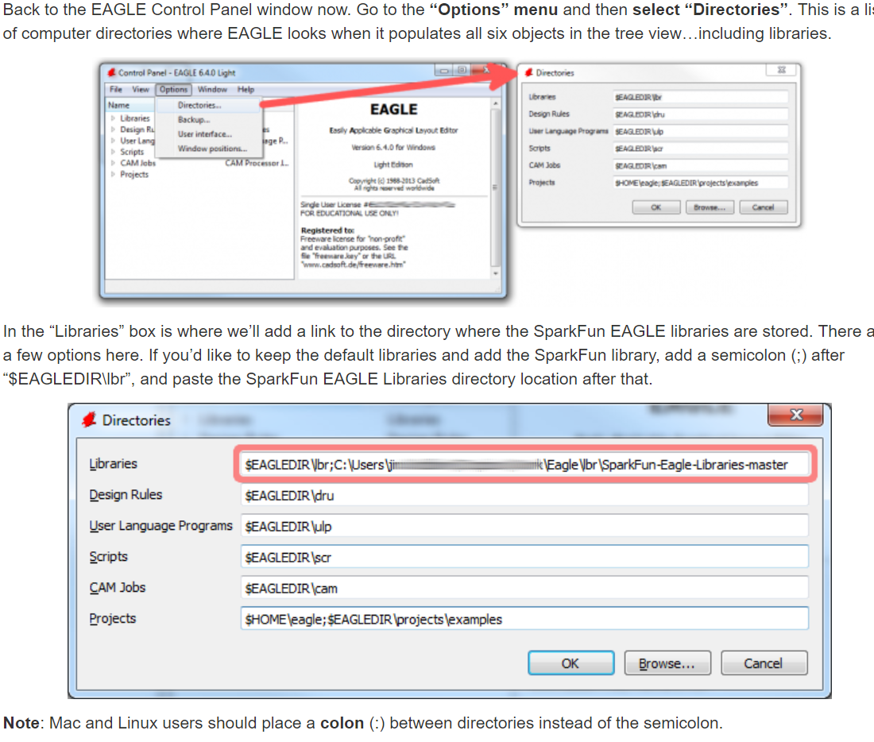
Add Libraries to Eagle
In the control panel, click on options > directories
In the new window, click on libraries, then click browse
In the extracted zip file from slide 2, click on the folder labelled “libraries” under workshops-master->eagle
Figure obtained from Sparkfun.com

Slide 18
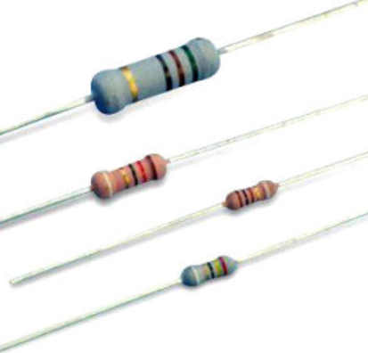
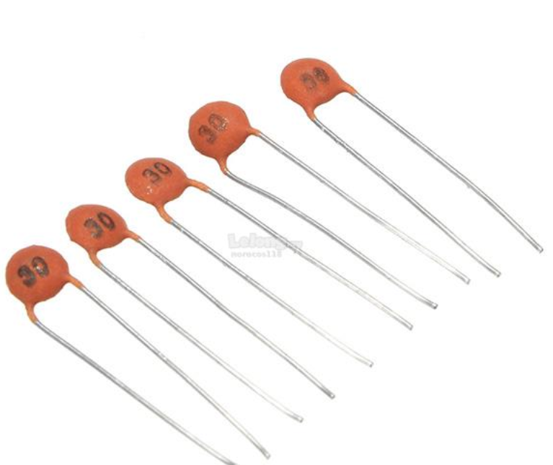
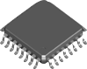
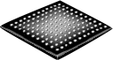
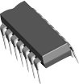

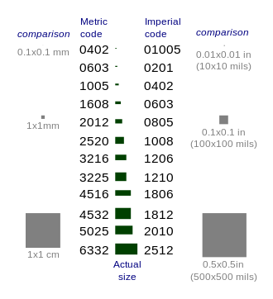
Component Terminology
Thru-Hole (TH)
Surface Mount (SMT)
LQFP, QFP, TQFP
QFN
BGA
DIP
Resistor
Capacitor
SMT Resistor and Capacitor Sizes

Slide 19
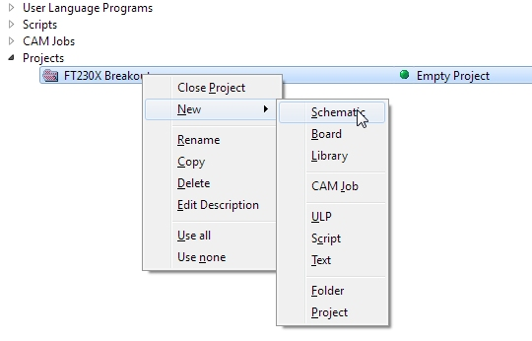
Creating a Schematic
Launch Eagle
File -> New -> Project
Enter Project Name: “myfirstPCB”
Active project is shown with a green light.
Right Click Project -> New Schematic

Slide 20
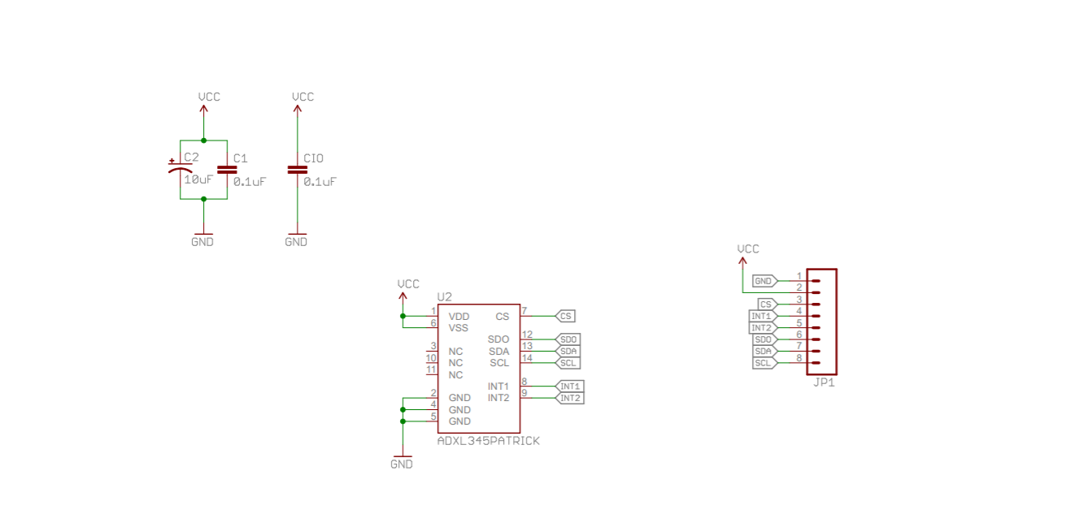
ADXL 345: Reference Schematic
Bypass capacitors
Accelerometer
Connector

Slide 21
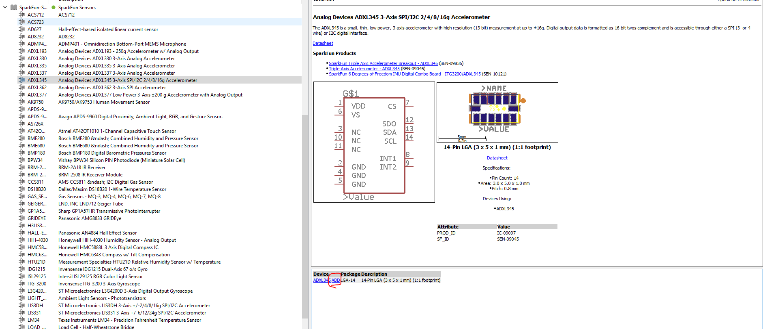
Add ADXL 345

Slide 22
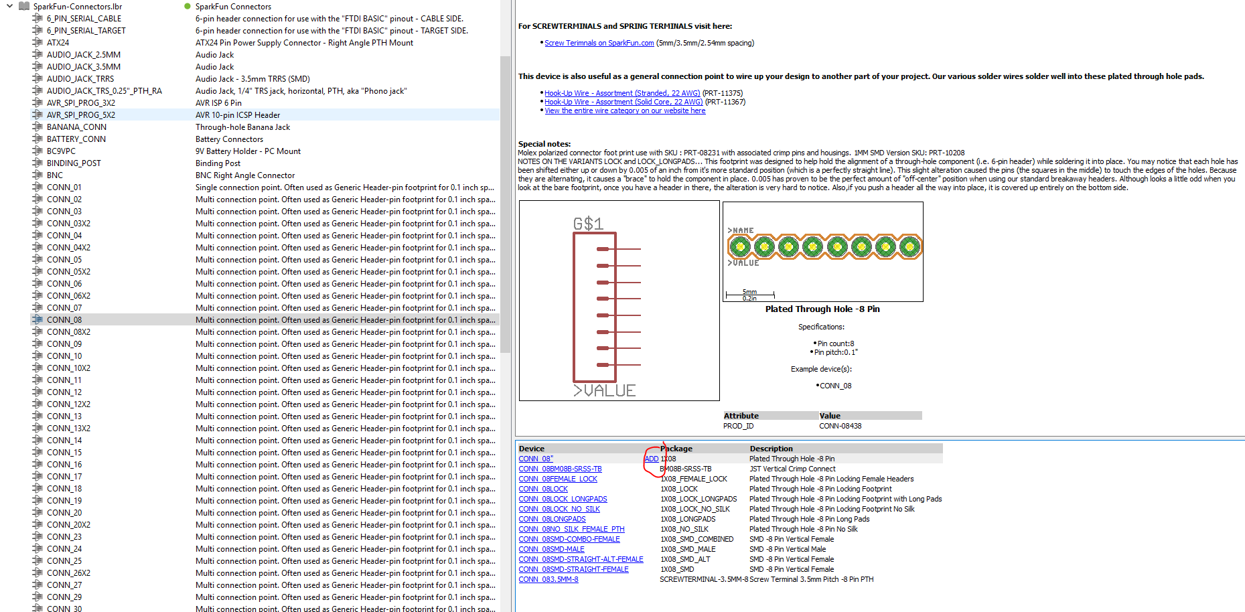
Add 8-pin connectors

Slide 23
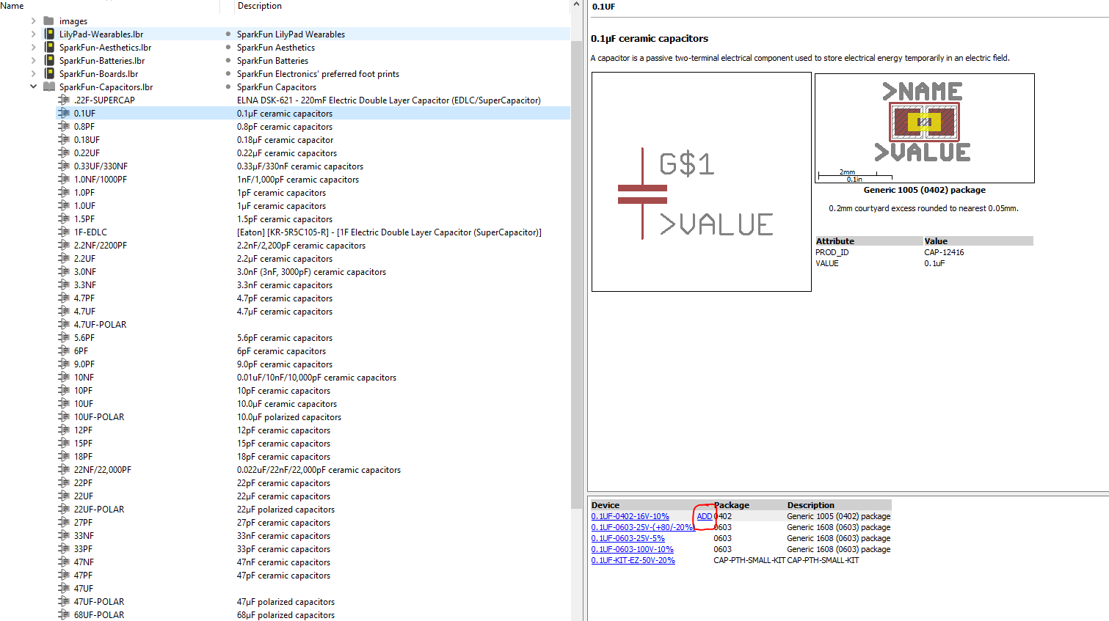
Add 0.1uF capacitor (x2)

Slide 24
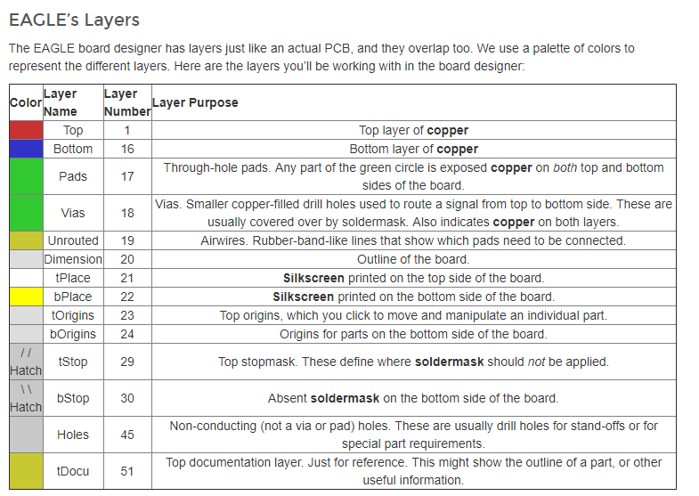
Board Layers

Slide 25
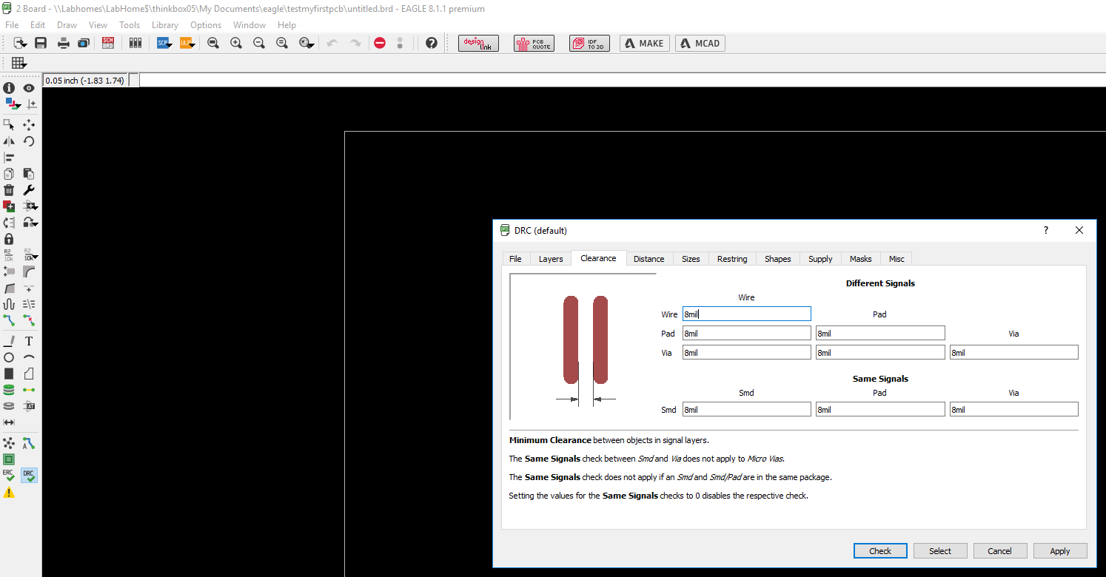
Design Rule Check

Slide 26
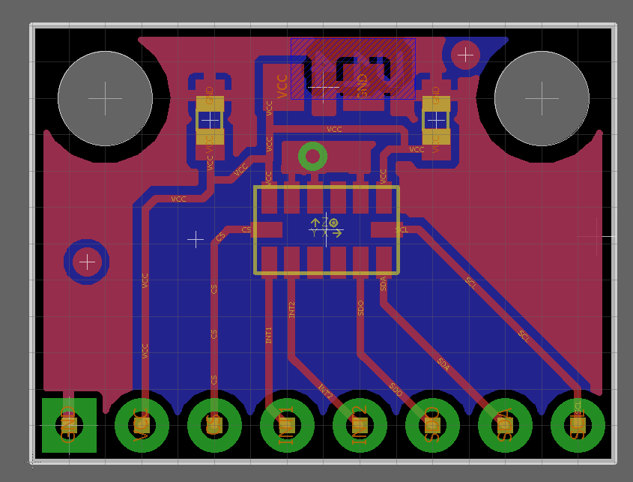
ADXL 345: Reference Board Layout
Capacitors
ADXL 345
Connectors

Slide 27
Order your PCB!
Oshpark: https://oshpark.com/
Standard service
$5/in^2 with three board copies – 2 weeks fabrication
Super-swift service
10/in^2 with three boards – 3 day fabrication
Thinkbox: http://thinkbox.case.edu/equipment/pcbrouter

Slide 28
General Advice
Design your board twice, print it once!
Mistakes on your PCB can cost you precious time to fix.
Making a board design more than once reduces the number of errors made and increases your efficiency at designing the board.
Recheck the design rules
Typically 8mils of clearance is ok (1mil = 1/1000th of an inch)
Schematic Capture
Place Components
Iteration
Route Traces
Generate Gerbers
Fab!

Slide 29
Where can I learn more?
Autodesk eagle:
http://eagle.autodesk.com/eagle/documentation
Sparkfun:
https://www.sparkfun.com/EAGLE

